Slide 1
Application Evaluation for AWS Rekognition
Edward Chen, Lizzy Fang, Duping Gao, Xindi Gong, Cecilia Ting

Slide 2
Catalog
Introduction
Hypothesis
Procedure and Setup
Industry Diagram
Preliminary Results
Plans for Final Presentation

Slide 3
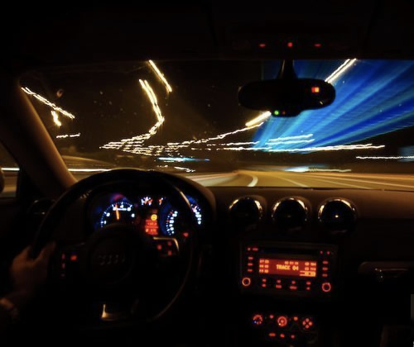
Motivation -- Our Story
Human Recognition/Vision Obstacles:
intense sunlights → light reflection from signs
rain & stormy weather → increased particles
blurring vision during the night
objects obscure road signs (e.g. tree branches)
Notes:
We all had this moment, especially in Georgia, with the intense sunlights and abundant rain during the summer, and blurring vision during the night, it is extremely hard to see some of the text on certain signs along the road. However, failure to recognize them create significant danger for us and also cars driving near us. For example, driving home at night, it is hard for human beings to recognize traffic signals accurately because of the low lighting value as well as high blurring value, which is the main contributor to the night traffic accidents.

Slide 4
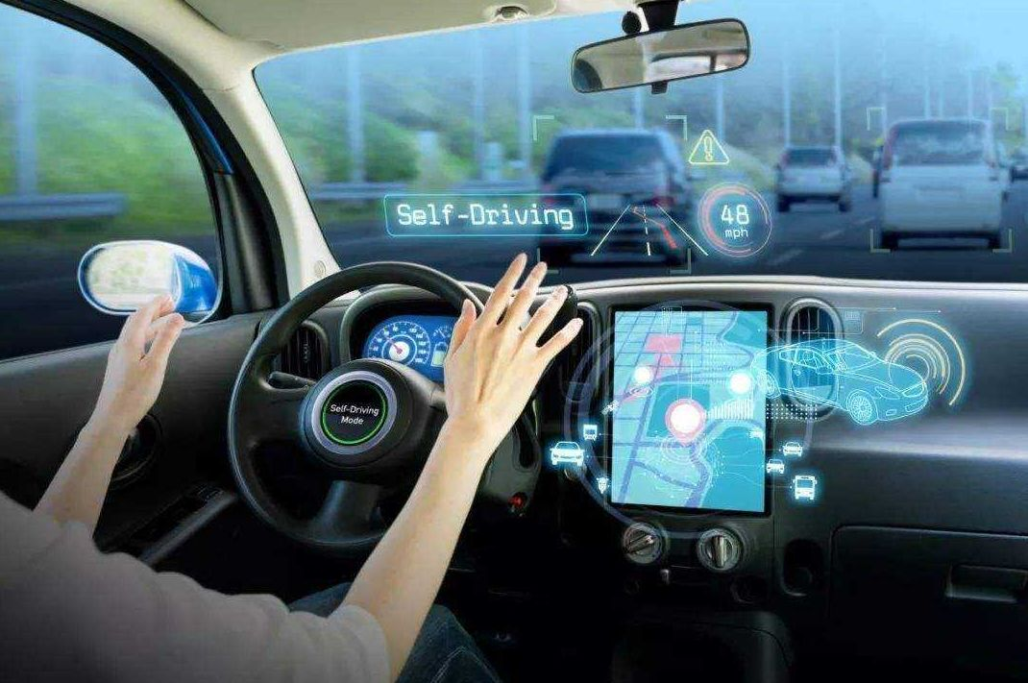
Introduction
Era of automatic pilot
Precision and accuracy recognition ability for automobiles
Our goal:
ML model for traffic sign text recognition
Artificially simulate image of traffic signs in real-life situation and test our hypothesis
Notes:
As machine learning technology develops, we now can finally touch the threshold of the era of automatic pilot. However, this technology requires precise and accurate recognition ability of the vision component of the automobiles. In this case, making sure that machine learning models have the strong ability to recognize the traffic signs under all circumstance will be nenessary.
In this experiment, our group will be artificially simulate image of traffic signs in different real-life conditions and test them against our research hypothesis.

Slide 5
Hypothesis
01
As we decrease and increase the brightness value of the image, AWS Rekognition will be less able to figure out the content on the sign correctly.
02
As we increase the particle value of the image, AWS Rekognition will be less able to figure out the content on the sign correctly.
03
As we increase the blurring value of the image, AWS Rekognition will be less able to figure out the content on the sign correctly.

Slide 6
Procedure
Took a sample picture of the typical U.S. traffic sign.
Used Adobe Photoshop to change different parameter of the image. Assigned different brightness, particle, and blury value
Imported images into AWS Rekognition to let it search for the text in the image.
Created statistical analysis and visualization for the results.

Slide 7
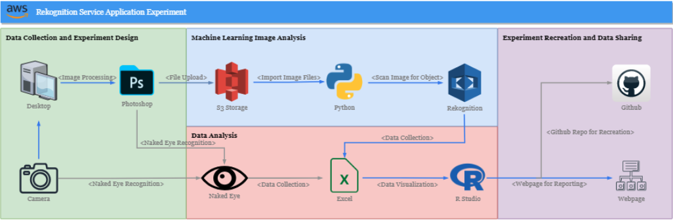
Industry Diagram

Slide 8
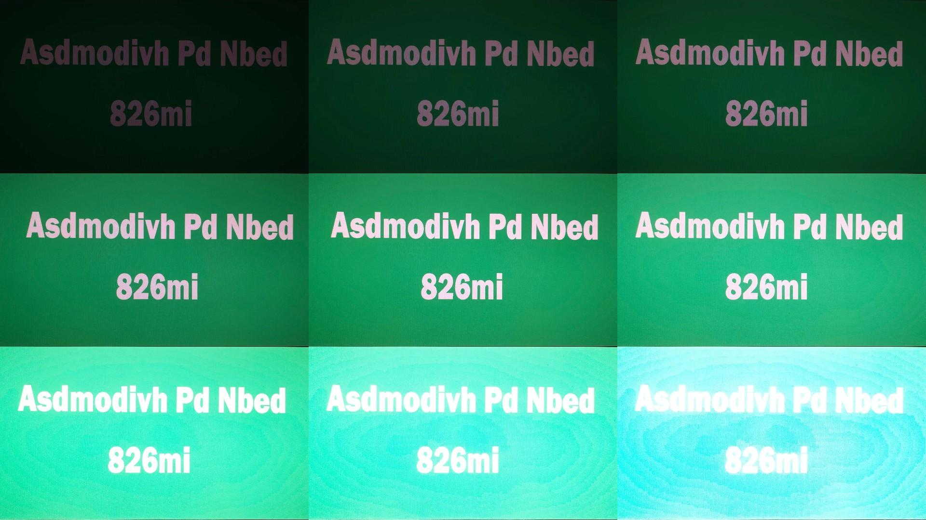
Brightness Values and Rekognition
We simulated 9 pictures of the same traffic sign and assigned differnt brightness values using Adobe PS. The light values have the range of [-200. 200].

Slide 9
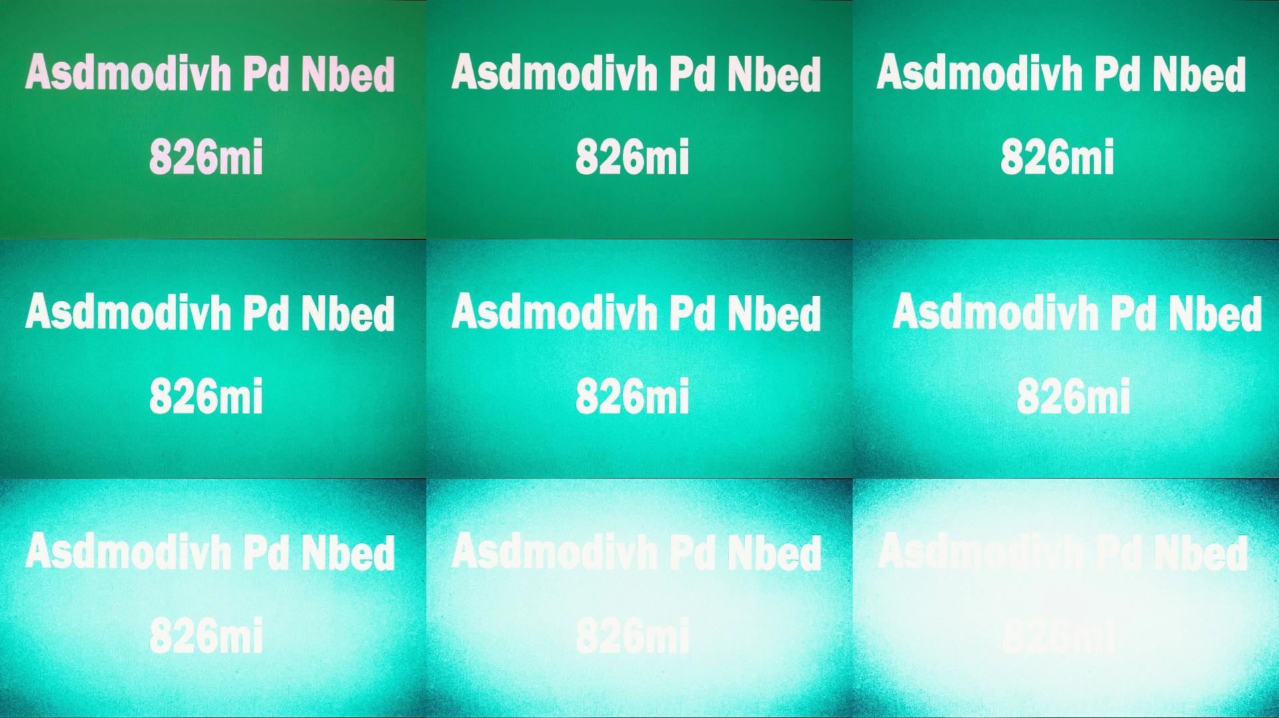
Particle Values and Rekognition
We simulated 9 pictures of the same traffic sign and assigned differnt particle values using Adobe PS. The particle values have the range of [0, 200].
Notes:
We have simulated 9 picture based on the same traffic sign and assiged different particle values from 0 to 200. You can see the diffence in the pictures that we used in the test.

Slide 10
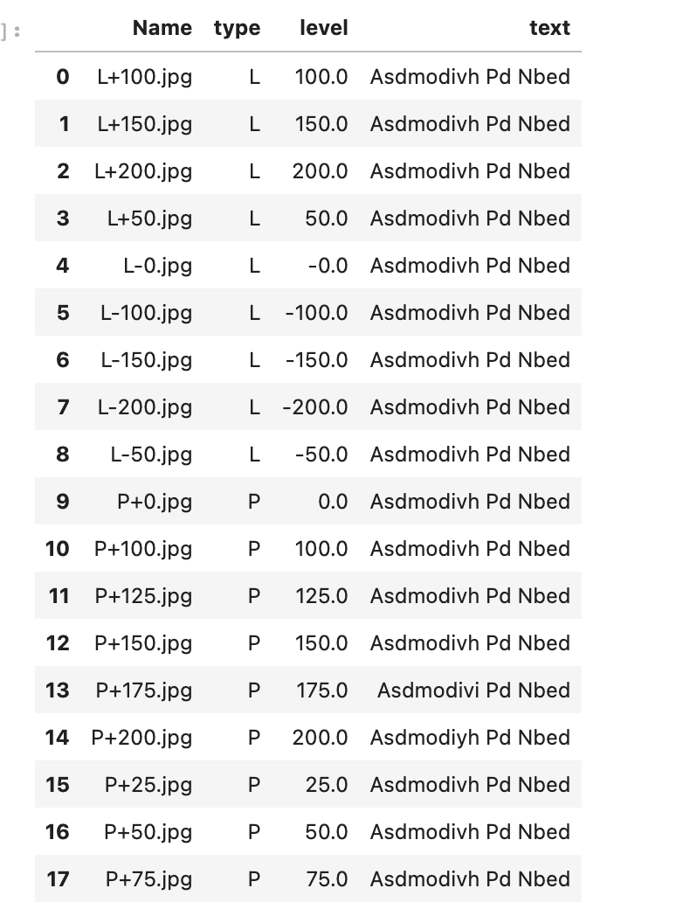
Brightness & Particle Value Test Result
Rekognition has successfully detect all of the text in signs with any level of brightness/particle we included in the sample.
Rekognition is doing a great job including lighting and particle value into consideration through preprocessing.

Slide 11
Plans for the Final Project
Regresion analysis
lighting & particle values V.S confidence
More features
Blurring (raindrop filter)
Image masking
Notes:
As mentioned previously, rekogntion has successfully detected all the signs with all levels of image modification. Thus, we are going to further explore the relationship between the change in lighting and particle values and its confidence through regression analysis. What’s more, we plan to impose more challenge to the rekogntion by adding filter to the images and explore its upper limit.

Slide 12
Thank you!

Slide 13

人物姓名
人物 1
在此处插入文本在此处插入文本在此处插入文本在此处插入文本在此处插入文本在此处插入文本在此处插入文本在此处插入文本在此处插入文本在此处插入文本在此处插入文本在此处插入文本在此处插入文本。
75%
83%
42%
17%
在此处插入文本
在此处插入文本
在此处插入文本
在此处插入文本

Slide 15
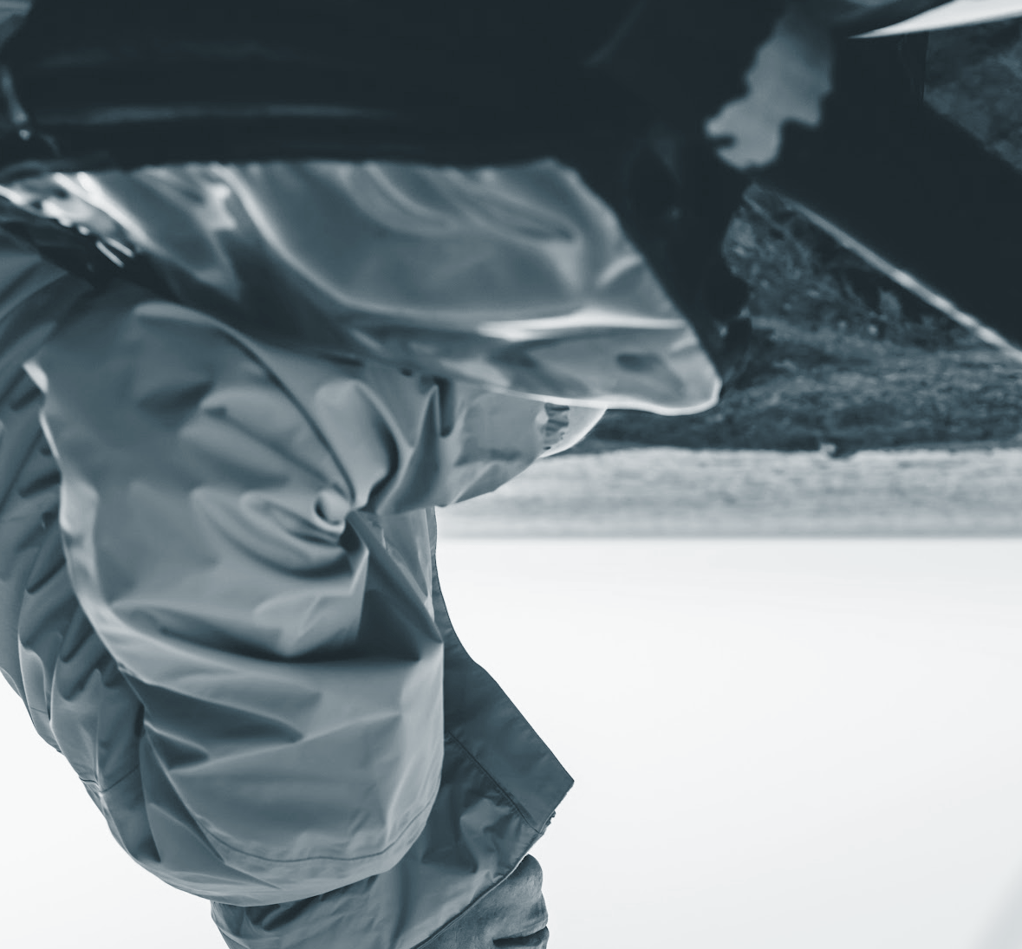
人物姓名
人物 2
在此处插入文本在此处插入文本在此处插入文本在此处插入文本在此处插入文本在此处插入文本在此处插入文本在此处插入文本在此处插入文本在此处插入文本在此处插入文本在此处插入文本在此处插入文本。
75%
83%
42%
17%
在此处插入文本
在此处插入文本
在此处插入文本
在此处插入文本

Slide 16
循环图
04
原型
改进
在此处插入文本在此处插入文本在此处插入文本。
在此处插入文本在此处插入文本在此处插入文本。
01
03
分享
获得反馈
在此处插入文本在此处插入文本在此处插入文本。
在此处插入文本在此处插入文本在此处插入文本。
02

Slide 17



介绍：在此处插入文本
展示您的工具如何在不同的设备上使用
在此处插入文本在此处插入文本在此处插入文本在此处插入文本在此处插入文本在此处插入文本在此处插入文本在此处插入文本在此处插入文本在此处插入文本在此处插入文本在此处插入文本。
小提示
您可以右键单击照片，然后选择“替换图片”，制作属于自己的原型展示。

Slide 18
移动设备
在此处插入文本在此处插入文本在此处插入文本在此处插入文本
在此处插入文本在此处插入文本在此处插入文本在此处插入文本在此处插入文本在此处插入文本在此处插入文本在此处插入文本在此处插入文本在此处插入文本在此处插入文本在此处插入文本在此处插入文本在此处插入文本。

Slide 19
移动设备的横向视图
在此处插入文本在此处插入文本在此处插入文本在此处插入文本在此处插入文本
在此处插入文本在此处插入文本在此处插入文本在此处插入文本在此处插入文本在此处插入文本在此处插入文本在此处插入文本在此处插入文本在此处插入文本在此处插入文本在此处插入文本在此处插入文本。

Slide 20
可穿戴设备
在此处插入文本在此处插入文本在此处插入文本在此处插入文本
在此处插入文本在此处插入文本在此处插入文本在此处插入文本在此处插入文本在此处插入文本在此处插入文本在此处插入文本在此处插入文本在此处插入文本在此处插入文本在此处插入文本在此处插入文本。

Slide 21
平板电脑
在此处插入文本在此处插入文本在此处插入文本在此处插入文本在此处插入文本
在此处插入文本在此处插入文本在此处插入文本在此处插入文本在此处插入文本在此处插入文本在此处插入文本在此处插入文本在此处插入文本在此处插入文本在此处插入文本在此处插入文本在此处插入文本在此处插入文本。

Slide 22
平板电脑的横向视图
在此处插入文本在此处插入文本在此处插入文本在此处插入文本在此处插入文本
在此处插入文本在此处插入文本在此处插入文本在此处插入文本在此处插入文本在此处插入文本在此处插入文本在此处插入文本在此处插入文本在此处插入文本在此处插入文本在此处插入文本在此处插入文本。

Slide 23
可穿戴设备
在此处插入文本在此处插入文本在此处插入文本在此处插入文本在此处插入文本
在此处插入文本在此处插入文本在此处插入文本在此处插入文本在此处插入文本在此处插入文本在此处插入文本在此处插入文本在此处插入文本在此处插入文本在此处插入文本在此处插入文本在此处插入文本在此处插入文本。

